Slide 1

Smart food monitoring system using IoT
TEAM MEMBERS
VASANTHAKUMAR M– RA2211017010055
ROMANUS IRUDAYA RAJ R- RA2211017010070
SURENTIRAN T RA2211017010071

Slide 2
ABSTRACT
The Smart Food Monitoring Device continuously checks the condition of stored food by monitoring its environment. It detects changes in temperature, humidity, and gas levels that indicate food spoilage. When the system senses that the food is starting to spoil, it gives a local alert using sound and lights and also sends a message to the user's mobile phone. It updates the user about the food status regularly, helping to take early action and reduce food waste. The system also allows remote monitoring through a connected IoT platform.

Slide 3
OBJECTIVE
To monitor food freshness by detecting changes in environmental conditions.
To alert users immediately when food spoilage is detected.
To send regular updates about food status to a mobile phone.
. To reduce food waste by enabling early action based on real-time monitoring.

Slide 4
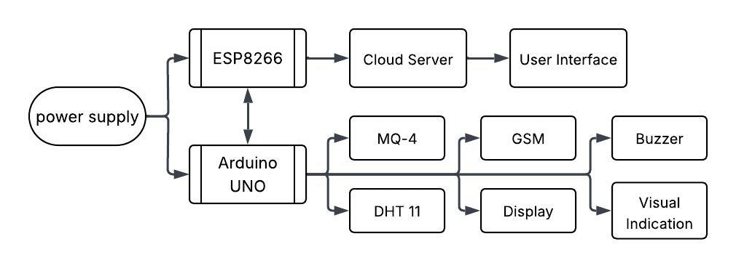
BLOCK DIAGRAM

Slide 5
COMPONENTS
Arduino Uno — (Main controller)
NodeMcu ESP8266 – (Secondary controller)
DHT11 Sensor — (Measures temperature and humidity)
MQ-4 Gas Sensor — (Detects methane gas indicating spoilage)
I2C LCD Display (16x2) — (Shows sensor readings and food status)
GSM Module (SIM800L) — (Sends SMS alerts)
Buzzer — (Gives audible alert when spoilage is detected)
Red and Green LEDs — (Indicates bad or good food condition)
DC 9V adaptor - (Power supply to the Controllers

Slide 6
CONCLUSION
The Smart Food Monitoring Device successfully monitors the freshness of stored food by analyzing gas emissions, temperature, and humidity levels. It displays real-time data on an LCD and provides immediate alerts through a buzzer, LEDs, and SMS notification if food spoilage is detected. This proactive system helps reduce food wastage by enabling early detection and ensuring timely action. It is easy to operate, cost-effective, and highly useful for homes, supermarkets, and warehouses..
The integration of GSM communication allows remote monitoring, which enhances the convenience and reliability of the system. Overall, the project achieves its objective of building a smart, efficient, and affordable food quality monitoring solution.

Slide 7
THANK YOU

